Slide 1

Viewing data
week6

Slide 2
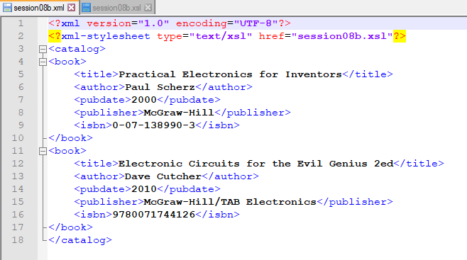

Slide 3
